Slide 1
Bike Share Prediction Analysis
Presented by
Himanshu Rathod

Slide 2
Purpose
The bike sharing business service where bikes are made available for shared use for individuals for a price. The bike can be picked up from a dock and returned to another dropping dock. The business thrives on volume game and seasonality impacts the revenue.
Goal / Objective: From the given data which is collected from the sales team (along the seasonal data), a model to be build to see how the count of bikes are impacted by different variables. Specifically the management want to know the factors affecting the demand for the bikes, which variable are significant in predicting the demand for shared bikes, and how well those variables describe the bike demands.

Slide 3
Steps involved in the EDA:
Data Loading and understanding.
Checking for missing values and duplicated values.
Data Wrangling to make data analysis ready.
Data Visualization – Univariate, Bivariate, and Multivariate analysis.
Heat maps and Pair plot.
Hot Encoding And Removing Multicolinearity.
Data Scaling – Min Max Scaler.
Data Splitting – Train test split.
Training data – Linear Regression.
Finding MSE and R-Squared Error.

Slide 4
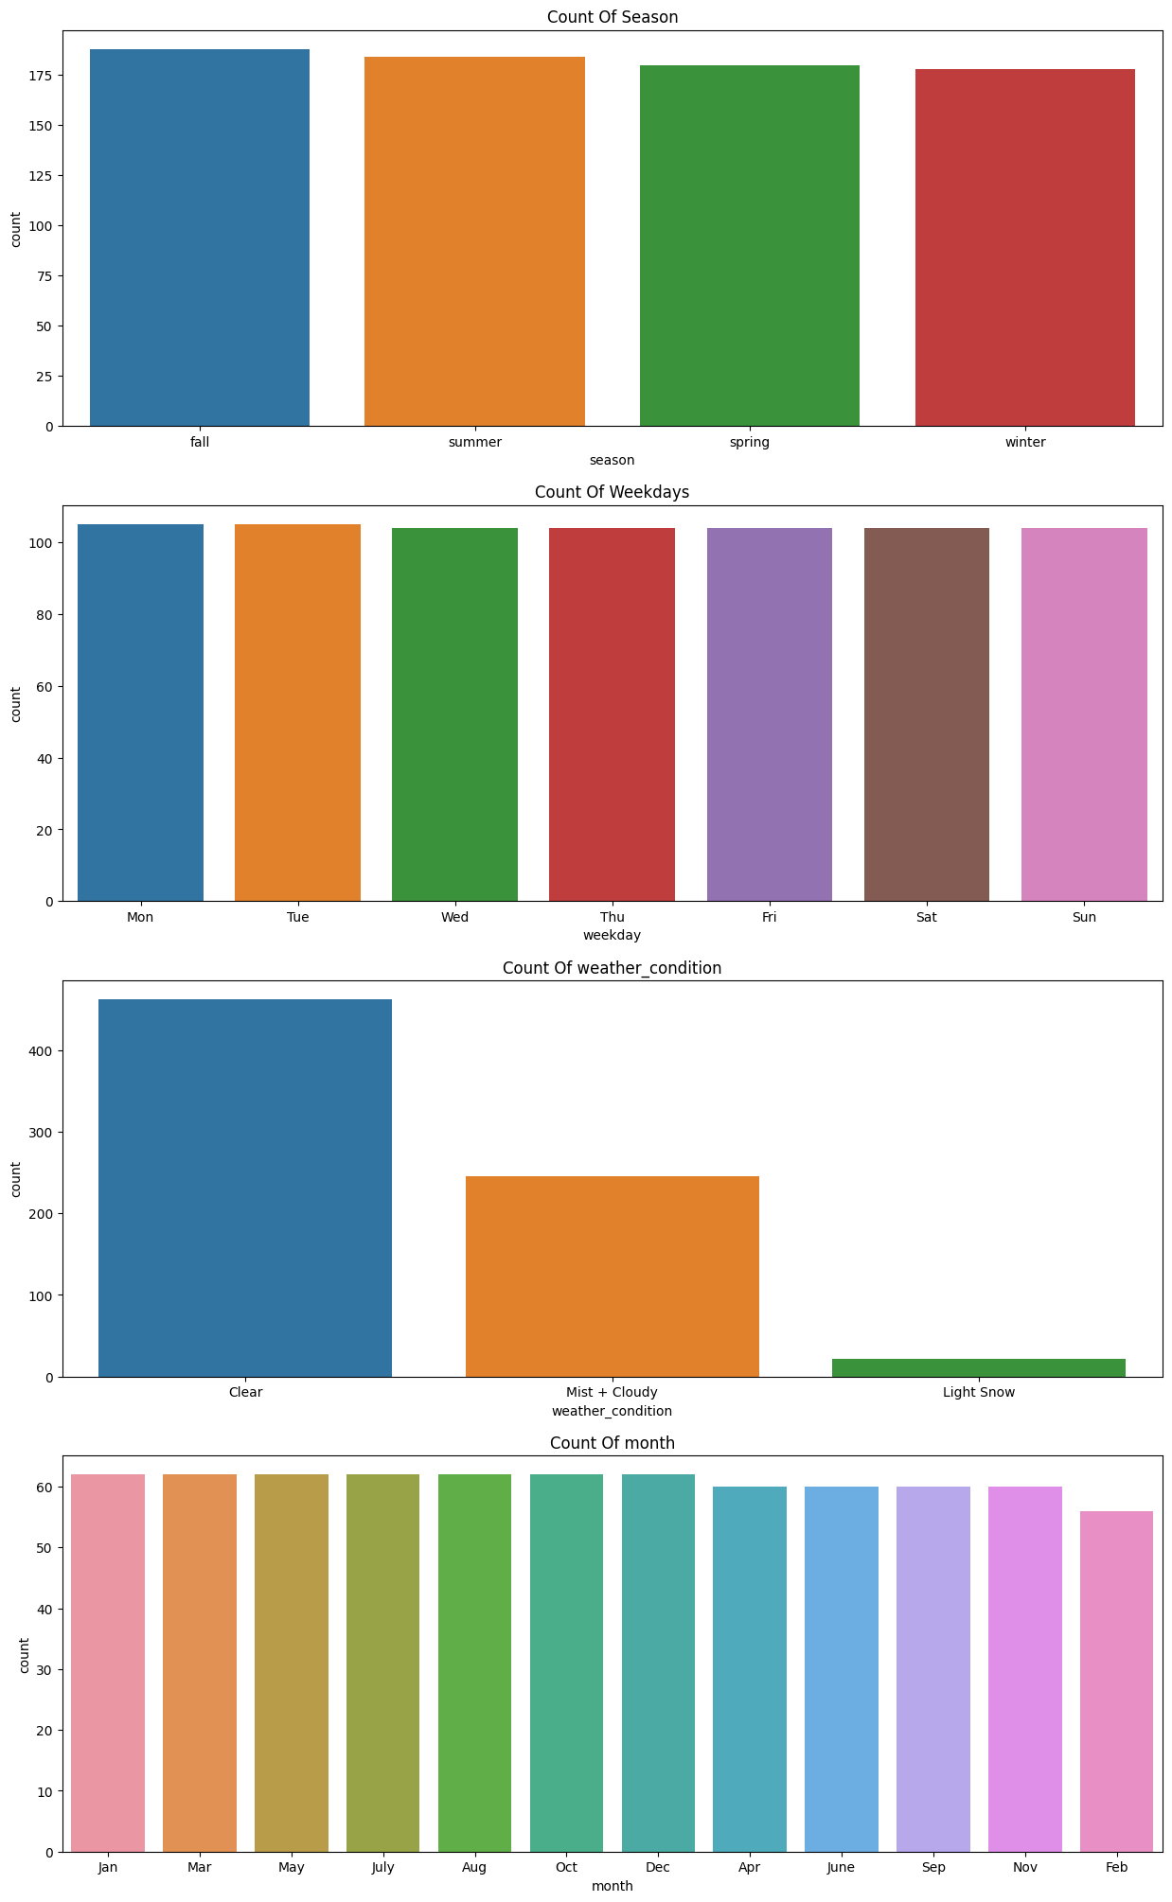
Approximately data is equally distributed to all the labels that are present in four columns only weather condition has more number of count in clear weather.

Slide 5
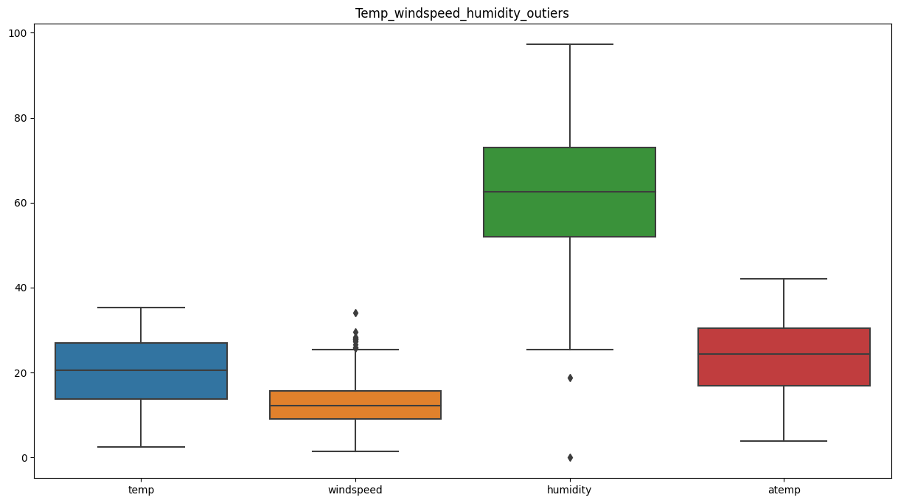
Humidity has outlier in it because humidity cannot be zero and windspeed in boxplot shows outliers but some cases, it will fluctuate with weather condition. And if talk about temp and atemp does not have any type of outlier in it.

Slide 6
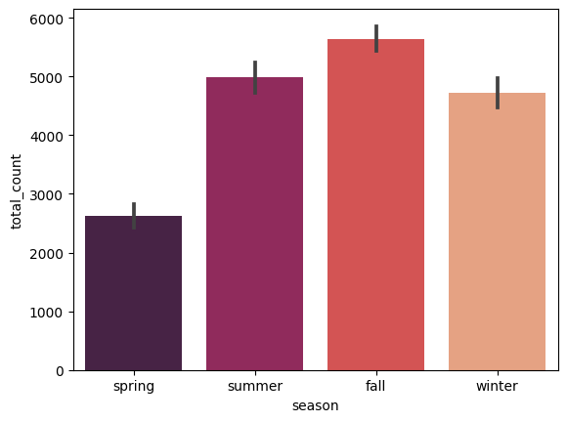
From the above analysis we can say that most of the bookings are in fall season due to cooler weather

Slide 7
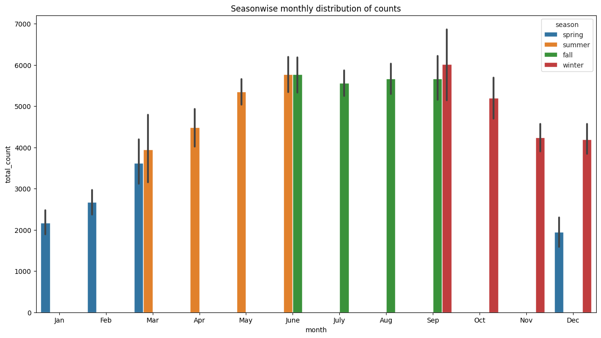
From the above plot, we can observed that increasing the bike rental count in fall and summer season and then decreasing the bike rental count in spring and winter season.

Slide 8
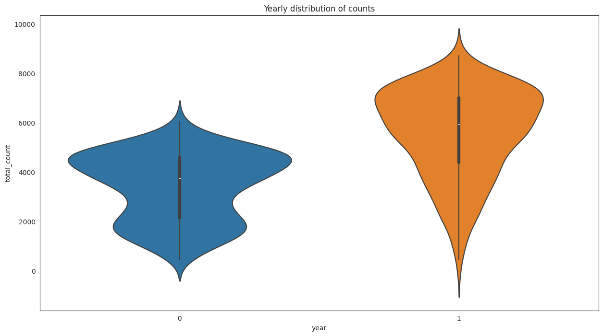
From the violin plot, we can observed that the bike rental count distribution is highest in year 2019 then in year 2018. Which means bussiness is growing day by day but due to covid face after 2019 it may affect the market scenario.

Slide 9
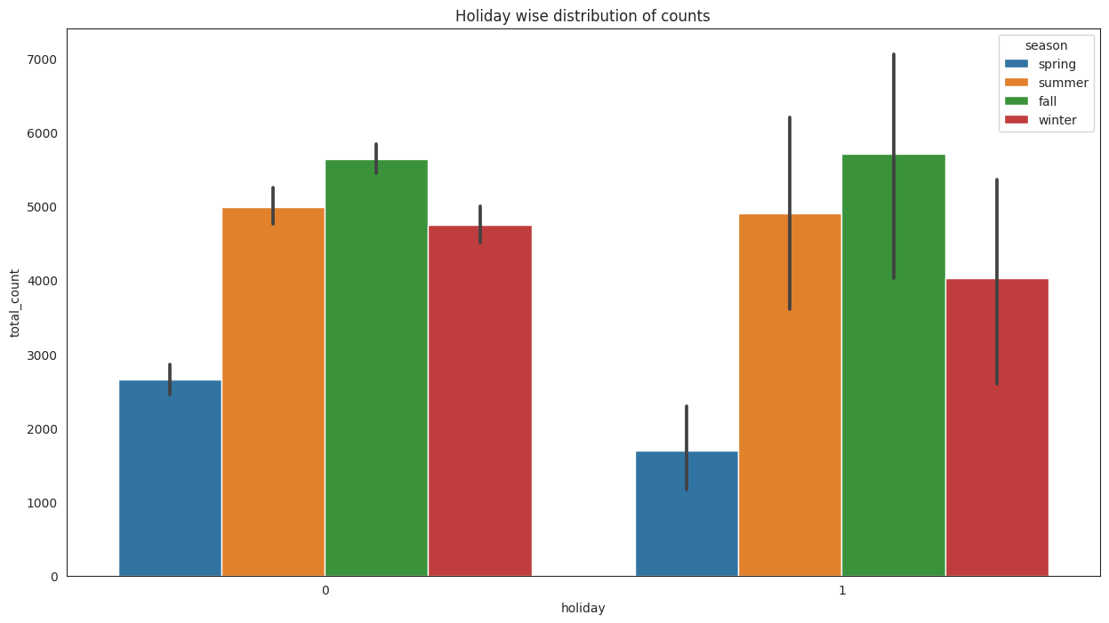
From the above bar plot, we can observed that during no holiday the bike rental counts is highest compared to during holiday for different seasons. In fall season it mostly rented.

Slide 10
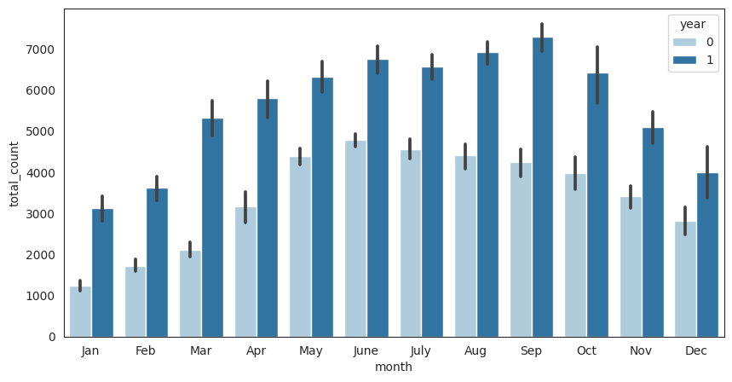
From the above analysis we can say that demand of rented bike increases rapidly as per time. And high demand of bike in between June to Sept month.

Slide 11
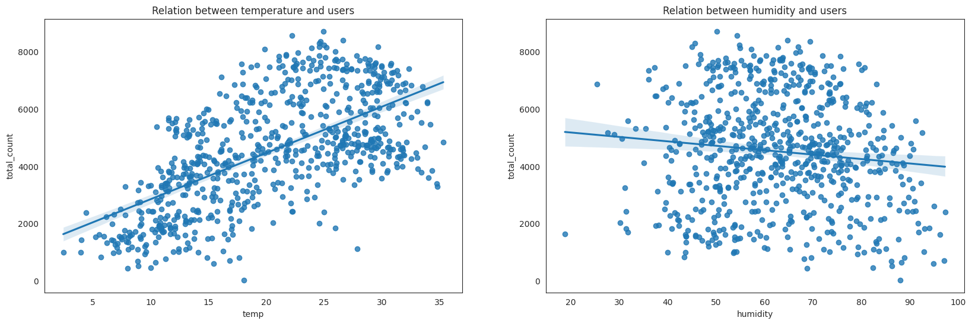
From the above analysis we can say that temp and user has positive correlation between them and humidity and user has negative correlation between each other. And hence we can say that when temp increases total count also increases and when humidity increases total count of rented bike will decrease.

Slide 12
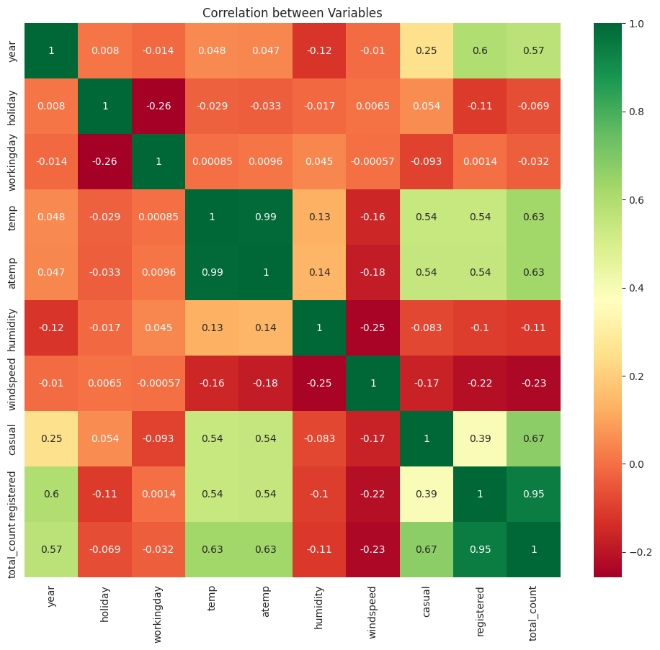
From the above analysis we can say that atemp and temp features are highly correlated to each other.
(i) temp and atemp (99%)
(ii) casual + registered = total_count
causal and registered columns cause Multicollinearity.

Slide 13
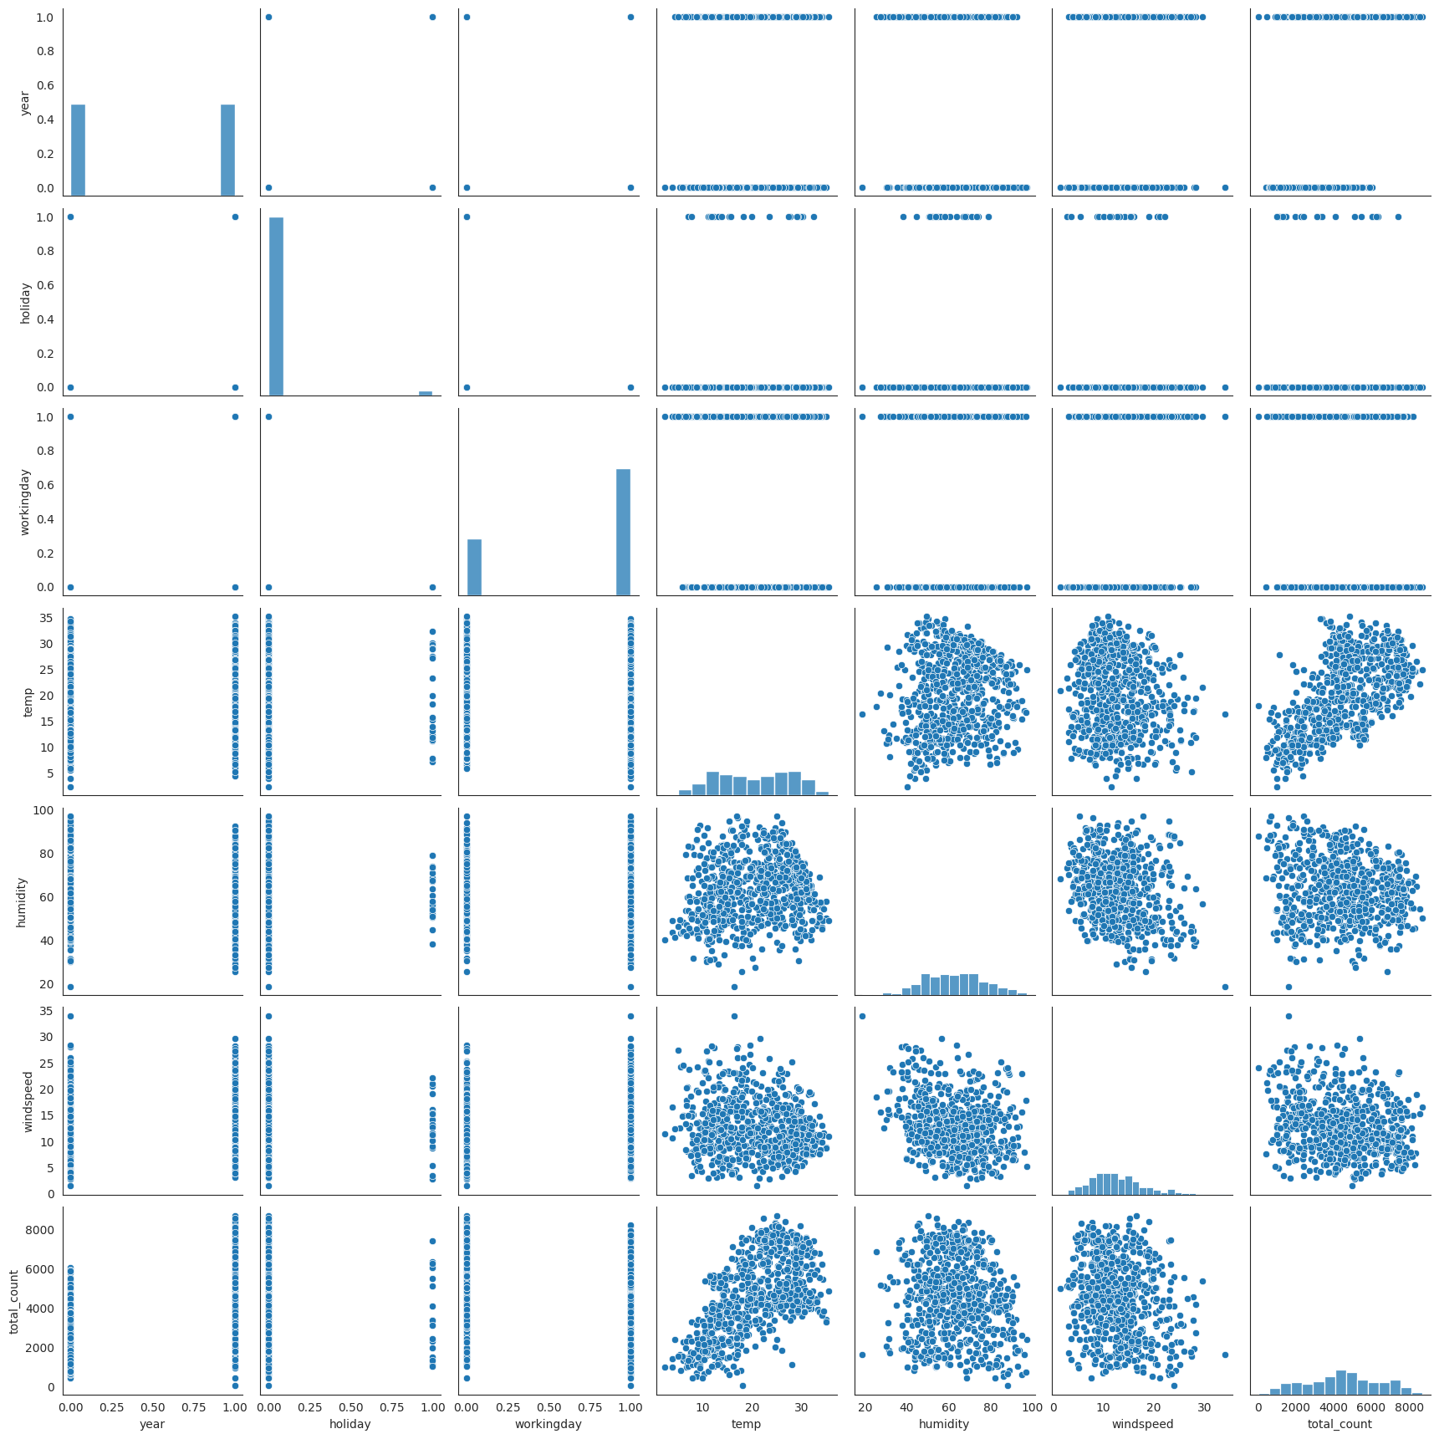
Pairplot representation of numerical to see there relation with each other about how they relate each columns.

Slide 14
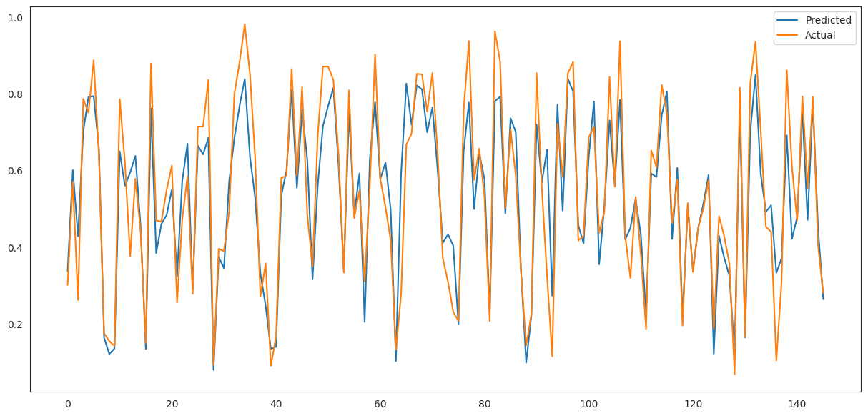
Actual Vs Predicted Points.

Slide 15
Most of the rentals are for commuting to workshops and colleges on a daily basis. So boom bikes should launch more stations near these landmarks to reach out to their main customers.
Planning for more sharing bikes to stations must consider the peak rental hours, i.e., 7-9 am and 5-6 pm.
The offer should not be a fixed price. Instead, it should be based on seasonal variations to promote bike usage during the fall and winter seasons. Data about the most used routes can help build roads/lanes dedicated to bikes specifically.
Due to the low usage of bikes at night, it would be better to do bike maintenance at night. Removing some bikes from the streets at night time will not cause trouble for the customers.
Converting registered customers to casual customers on the weekends by providing them with discounts and coupons.
Conclusion

